Slide 1
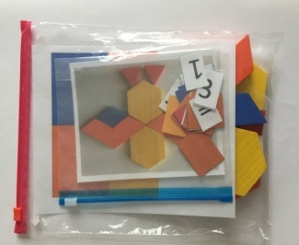
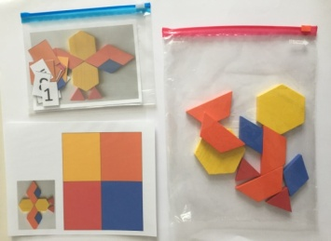
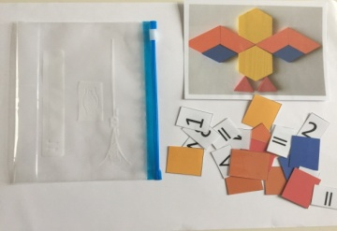
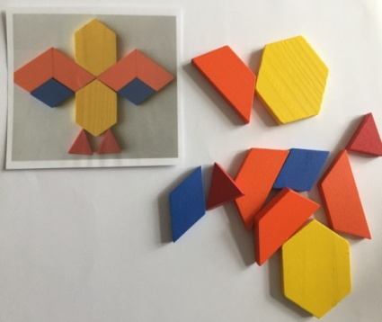
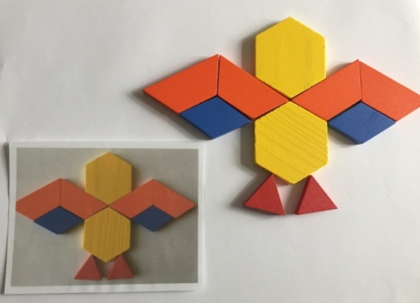
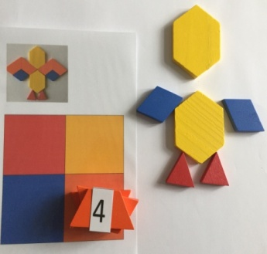
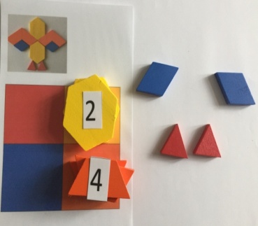
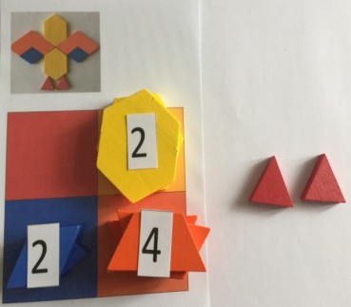
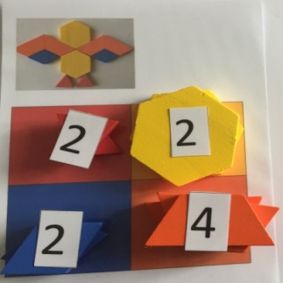
ANIMALS Numbers and value of the numbers
Data Manegemet
first
One hour
JERNEJA BERGANT BELAJ,
Primary school : OŠ VIČ, LJUBLJANA, SLOVENIA
Counting and colour recognition
Comparing numbers
Editing data
Working in groups
7 bags
The bag contains :
- painted wooden shapes
- table of colours
- the picture of the animal
- numbers and symbols <, =,>
1. INTRODUCTION
repeat numbers up to 20
counting numbers back and forth from 1 to 20
comparing numbers with each other and editing in size
2.THE MAIN PART OF THE LESSON
divide students into 7 groups. Each group should have 3-4 players
each group gets one game bag
teacher reminds players TO HANDLE CAREFULLY
The game and to REMEMBER which parts of the game are in which bag.
1. THE FIRST PLAYER MAKES THE ANIMAL
2. THE SECOND PLAYER PUTS THE ELEMENTS ON RIGHT COLOURS
1. 2. 3. 4.
3. AT THE SAME TIME THE THIRD PLAYER COUNTS THE ELEMENTS AND PLACE THE CORRECT NUMBERS ON THE PILE.

Slide 2
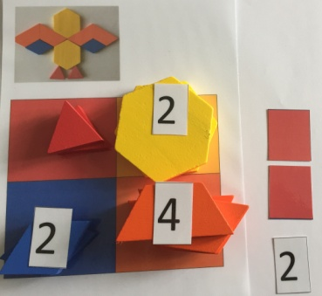
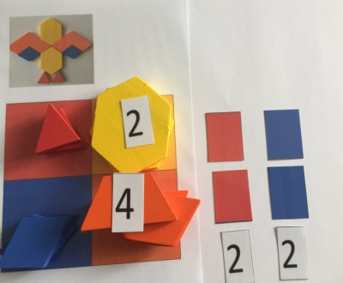
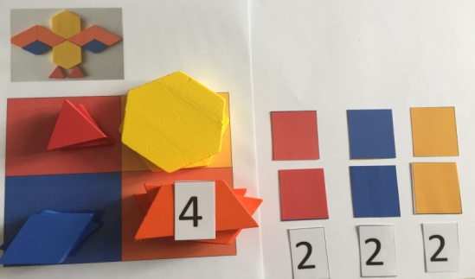
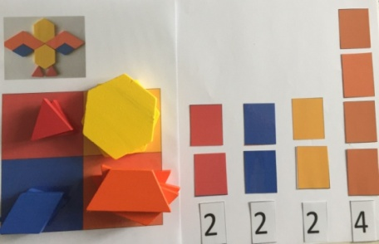
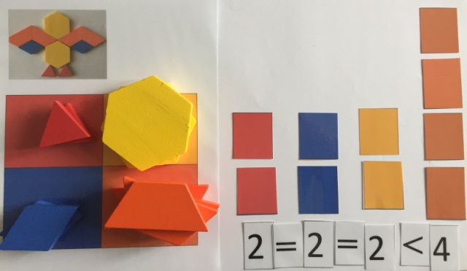
4. THE FOURTH PLAYER OR ALL PLAYERS MAKE A COLUMN DIAGRAM
ALL PLAYERS COMPARE THE NUMBERS WITH EACH OTHER, THEN THEY PUT SIMBOLS BETWEEN THE NUMBERS.
FOR RETURN INFORMATION THEY CALL A
TEACHER TO CHECK, IF THEY SOLVE THE
GAME CORRECTLY.
3. CONCLUSION
TEACHER GIVES INSTRUCTIONS TO THE PLAYERS :
ALL GAME ELEMENTS PUT CAREFULLY IN THE RIGHT BAGS. WHEN YOU ARE FINISHED,
PASS THE GAME TO THE OTHER GROUP NEARBY.
ALL THE PLAYERS AND THE GROUP PLAY 7 TIMES/ 7 DIFFERENT GAMES .
IN EVERY GAME THEY CHANGE THE ROLE IN THE GROUP.

